Slide 1
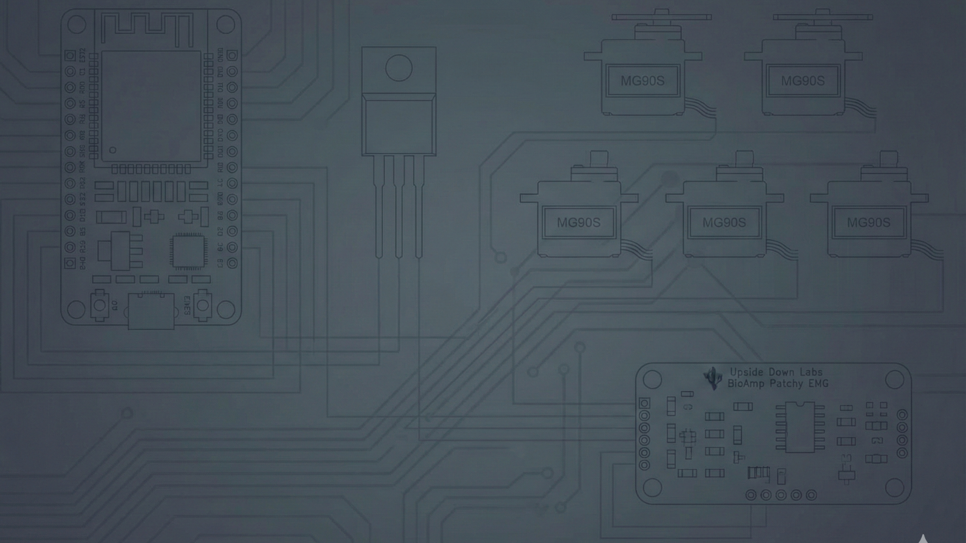
BIONEX
Hybrid BCI-Controlled Robotic Prosthetic Arm
Engineering Final Project: BCI and ESP32 Based

Slide 2



PROBLEM STATEMENT & OBJECTIVE
THE PROBLEM
THE OBJECTIVE
Advanced prosthetics are expensive (>$10,000) and often inaccessible.
To develop a low-cost, 3D-printed bionic arm (Inmoov-based) using a hybrid brain-computer interface (BCI).
Existing low-cost myoelectric (EMG-only) solutions lack the adaptability needed for complex tasks, requiring awkward muscle commands for mode-switching.
The system fuses:
•
EMG: Proportional control for grasping force.
•
EEG: Cognitive commands (attention, eye blinks) for mode/gesture switching.

Slide 3
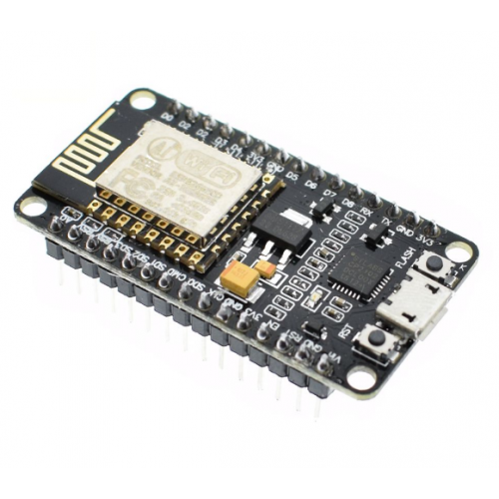

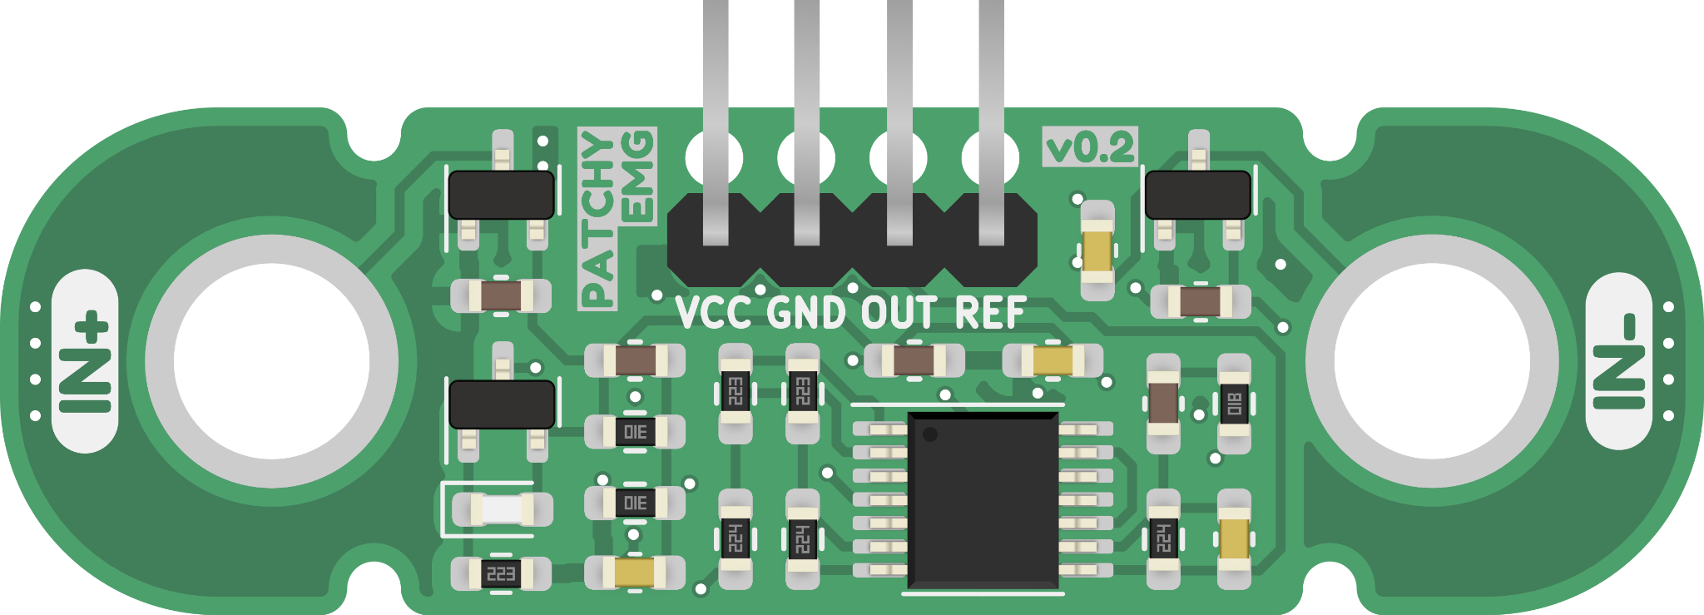

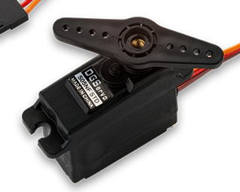

CORE HARDWARE COMPONENTS
ESP32 MICROCONTROLLER
EEG SENSOR (BCI)
BIOAMP PATCHY (EMG)
MG90s SERVOS (X5)
Processing for real-time sensor data and control.
Reads cognitive signals for gesture mode switching.
Detects muscle potentials for grasping action.
High-torque actuators for finger control and force.

Slide 4
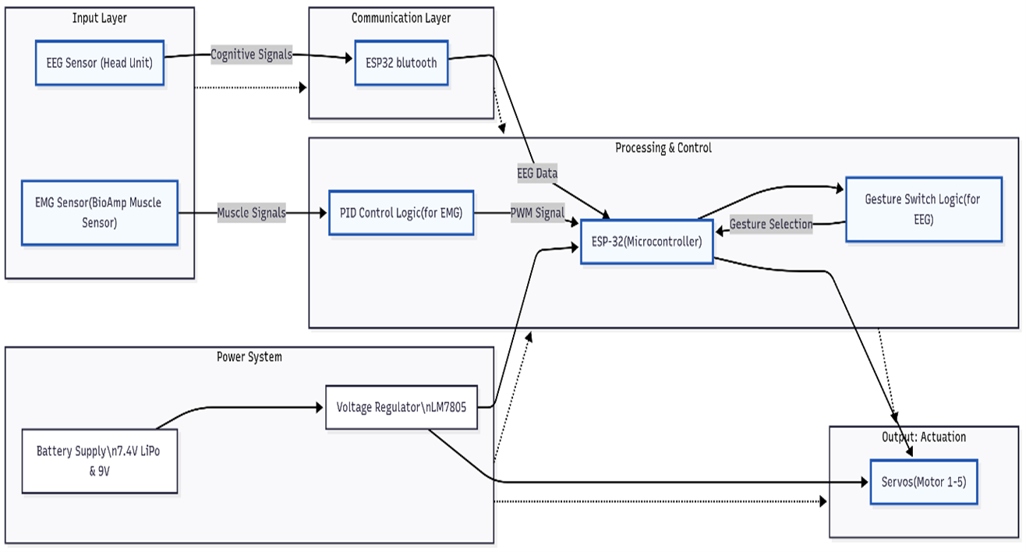
SYSTEM ARCHITECTURE: BIONEX HYBRID CONTROL
ARCHITECTURE LAYERS
Input Layer: EMG (Muscle) and EEG (Cognitive) signals are acquired.
Communication Layer: Bluetooth links EEG data to the ESP32.
Processing & Control: ESP32 handles dual logic and actuation.
Output Layer: 5 Servos control the 3D-printed Inmoov hand structure.

Slide 5


EMG & ADC SIGNAL CONDITIONING
EMG FOR PROPORTIONAL CONTROL
EMG amplitude is directly proportional to the force of muscle contraction.
ADC SAFETY & NOISE REDUCTION
The analog EMG output is conditioned for the ESP32's 3.3V ADC input using a voltage divider (10kΩ/22kΩ).
Digital filtering (moving average) is crucial to reduce high-frequency muscle noise and ensure a stable control signal.
The system translates varying muscle intensity into a smooth range of servo positions, allowing for nuanced grasping.

Slide 6




DUAL SIGNAL PROCESSING PIPELINE
EEG PROCESSING (SWITCHING)
EMG PROCESSING (ACTION)
Goal: Switch between programmed gestures.
Goal: Proportional control of grasp.
•
Attention/Meditation Levels from BCI data.
•
Rectification & Envelope Generation
•
Blink detection for instantaneous switching.
•
PID Control Logic (for smooth force application)
•
Output: Discrete State Change (e.g., from Pinch Mode to Power Grasp Mode).
•
Output: Continuous servo position angle.

Slide 7

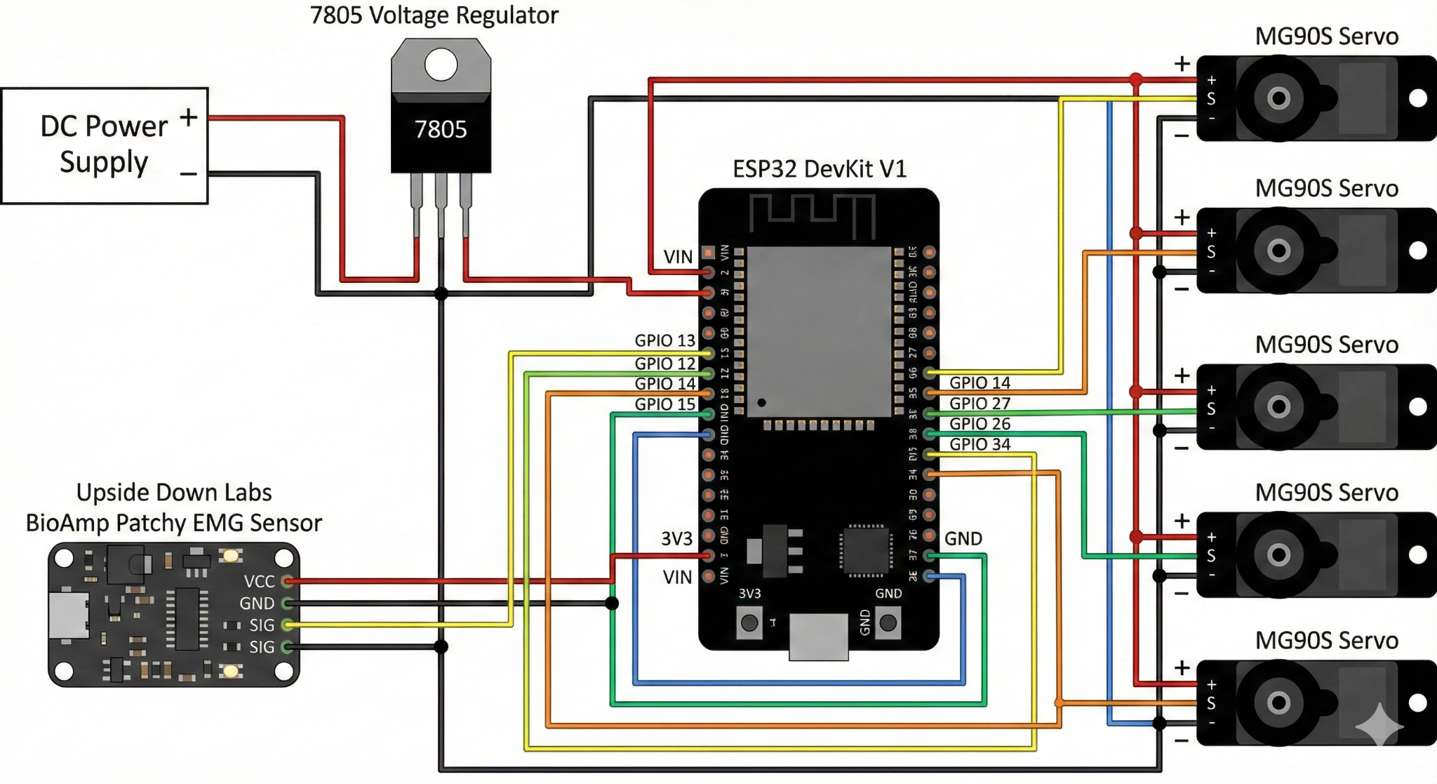
CIRCUIT & MECHANICAL INTEGRATION
Mechanical Base: The hand and forearm were constructed using 3D-printed parts based on the open-source Inmoov project.
Power Safety: A powerful external 5V PSU (3-5A) is mandatory for the 5 MG996R servos.
Common Ground: Essential link between the external PSU and the ESP32 for stable control.
Actuation: 5 servos mapped to 5 distinct ESP32 LEDC PWM channels.

Slide 8


ACTUATION: PWM AND SMOOTH MOTION
LEDC HARDWARE PWM
The ESP32's LEDC peripheral generates stable, high-resolution PWM signals (10-12 bit) necessary for precise and smooth servo positioning.
SERIAL MOTOR CONTROL MODE
ANGLE STEPPING
A secondary mode implemented via serial commands (e.g., s1 90, all) 180) allows for:
Instead of instantaneous movement, the code uses incremental angle steps.
•
Precise servo calibration and trimming.
•
The servo target angle is reached gradually.
•
Debugging complex movement sequences.
•
Result: Fluid, natural motion, preventing abrupt mechanical wear.
•
Manual testing of the high-torque MG90s servo motors.

Slide 9
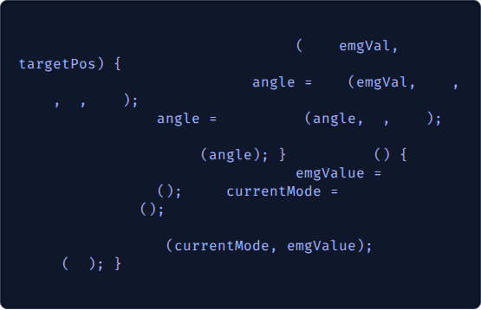
SOFTWARE IMPLEMENTATION & ALGORITHM
CORE ALGORITHM
// Simplified Servo Update Logic for Proportional Control
The system is governed by a state machine:
void
updateServoPosition
int
int
// Map filtered EMG (e.g., 500-4095) to Servo Angle (0-180)
Mode Determination: EEG data sets the current hand gesture/state (e.g., Pinch, Relax, Power).
int
map
500
4095
// Limit movement to prevent mechanical lock
0
180
constrain
0
180
// Smooth transition using angle steps
incrementallySetServo
// 1. Read Inputs (EMG & BCI/EEG)
void
loop
Execution: EMG data determines the proportional force/position within that selected state.
int
readAndFilterEMG
int
getGestureMode
// 2. Execute Action based on Mode and EMG
// From EEG/BCI
Calibration: Dynamic thresholds (Relax/Flex) are established upon startup.
executeModeAction
delay
20

Slide 10
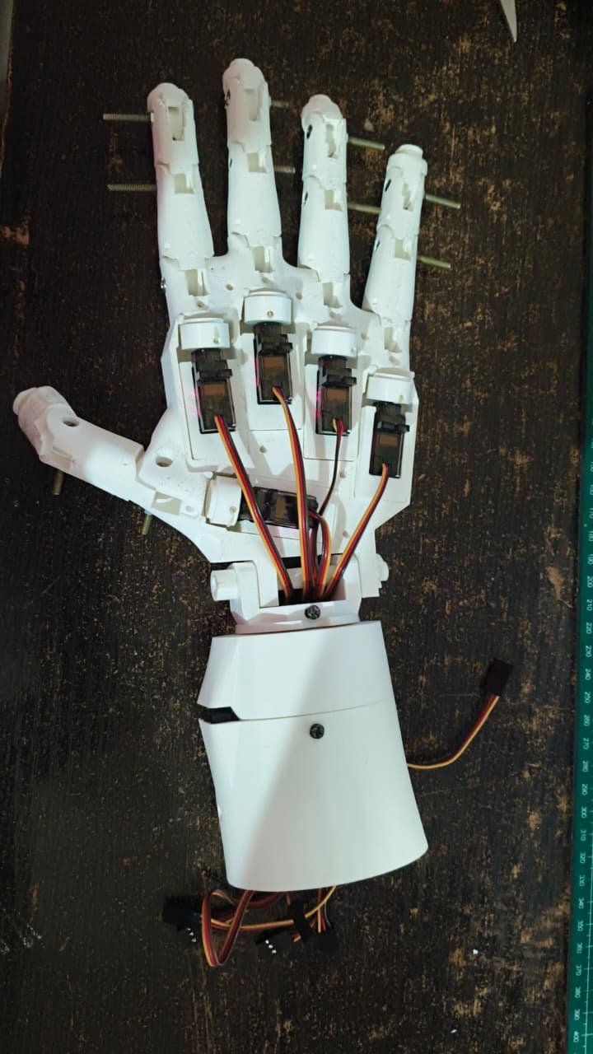
RESULTS & VALIDATION
Hybrid Control: Successful demonstration of **EEG mode switching** (e.g., blink to change grip) and **EMG proportional grasping**.
Reliability: Anti-chatter logic and dynamic calibration ensure stable operation.
Mechanical: The 3D-printed Inmoov structure provided the low-cost, modular base required.
Performance: High-torque MG996R servos provided sufficient force for grasping common objects.

Slide 11






FUTURE SCOPE
SENSORY FEEDBACK
MINIATURIZATION
LIPO POWER & MANAGEMENT
Integrate pressure/haptic sensors in fingertips to provide real-time force feedback to the user.
Develop a custom, shielded PCB to integrate all components (EMG/BCI receiver) into a small, wearable form factor.
Develop a robust, integrated LiPo battery management system (7.4V) for full portability and extended use.

Slide 12

CONCLUSION
BIONEX successfully validates the concept of a hybrid BCI prosthetic arm that is both highly functional and economically viable.
The fusion of EMG for proportional action and EEG for cognitive mode-switching provides a more intuitive and versatile control scheme than traditional myoelectric devices.

Slide 13
THANK YOU
Questions?
github.com/IAbhisek/BIONEX

